Slide 1
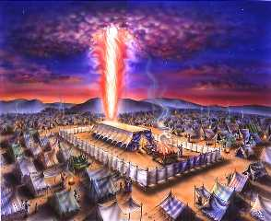
THE TABERNACLE

Slide 2
Exodus 25:8
And let them make me a sanctuary; that I may dwell among them.

Slide 3
Exodus 25:9
According to all that I shew thee, after the pattern of the tabernacle, and the pattern of all the instruments thereof, even so shall ye make it.

Slide 4
A Heavenly Pattern
Hebrews 12:8 …We have such an high priest, who is set on the right hand of the throne of the Majesty in the heavens;
Hebrews 8:2 A minister of the sanctuary, and of the true tabernacle, which the Lord pitched, and not man.

Slide 5
Heb 9:21 Moreover he sprinkled with blood both the tabernacle, and all the vessels of the ministry.
Heb 9:22 And almost all things are by the law purged with blood; and without shedding of blood is no remission.
Heb 9:23 It was therefore necessary that the patterns of things in the heavens should be purified with these; but the heavenly things themselves with better sacrifices than these.

Slide 6
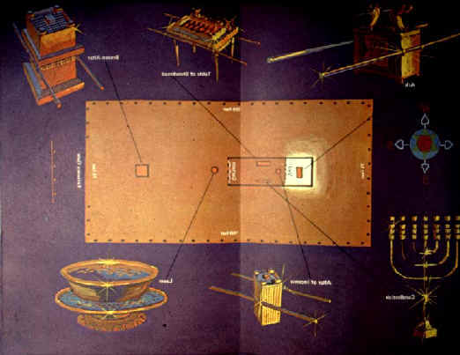

Slide 7
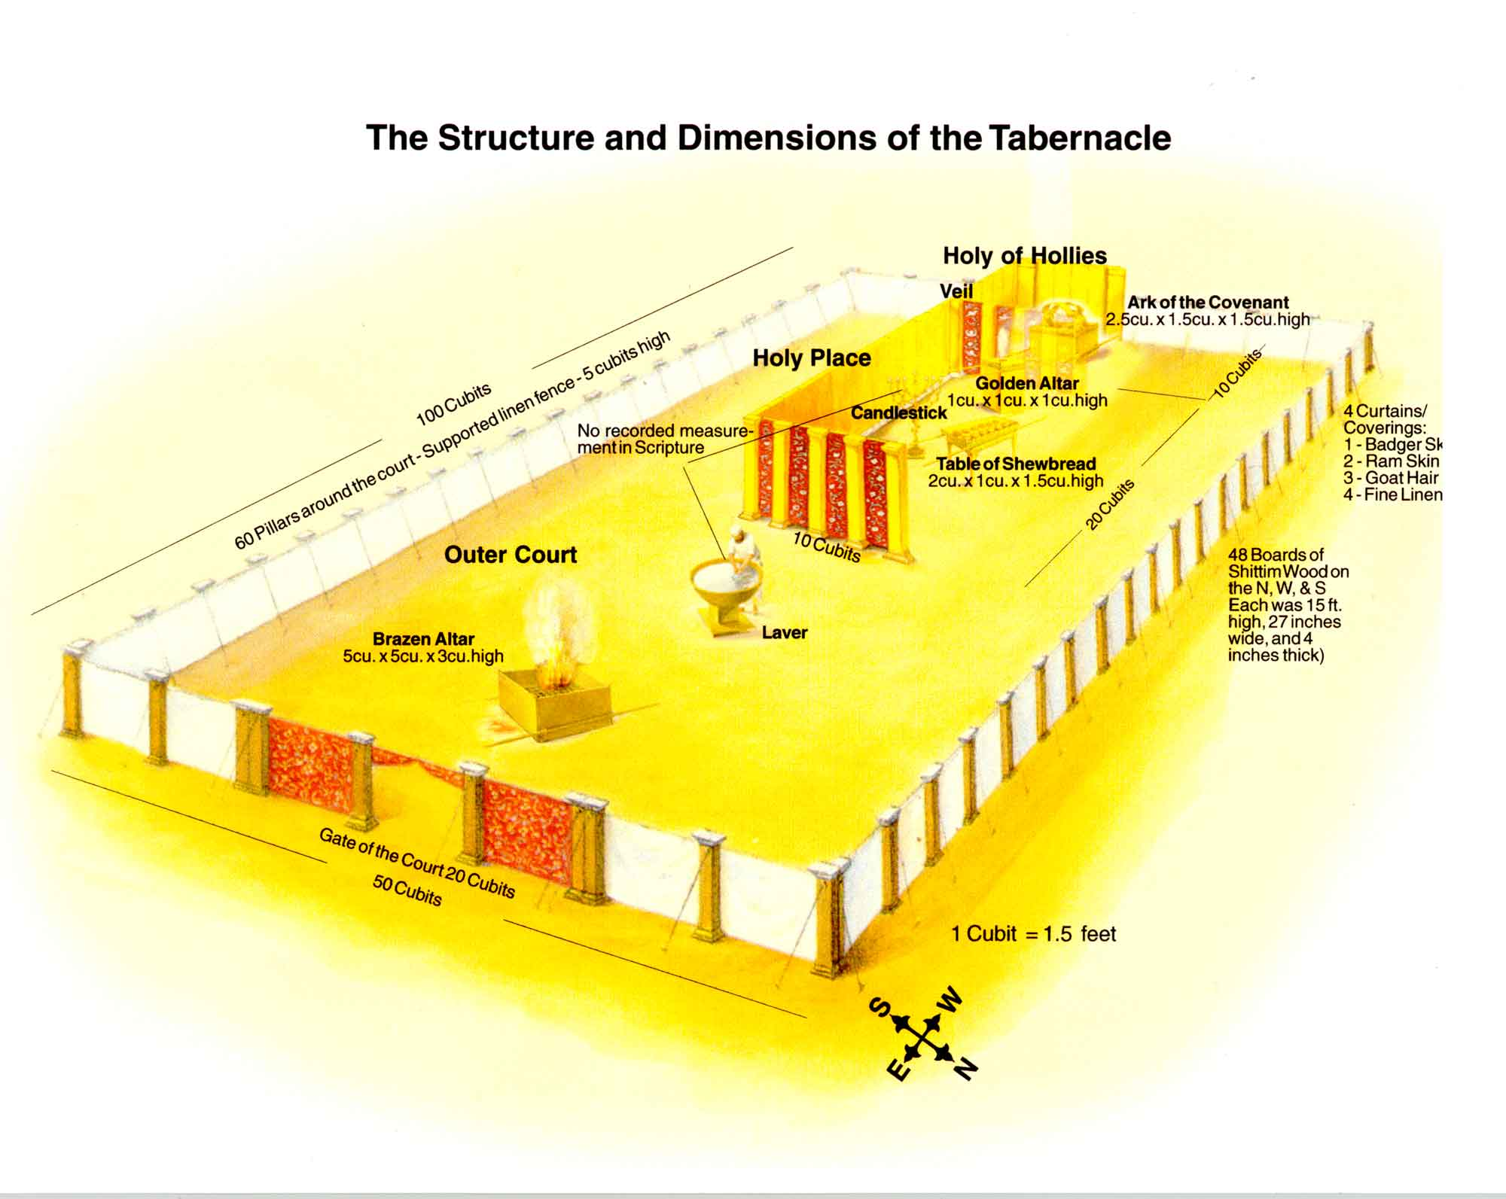

Slide 8
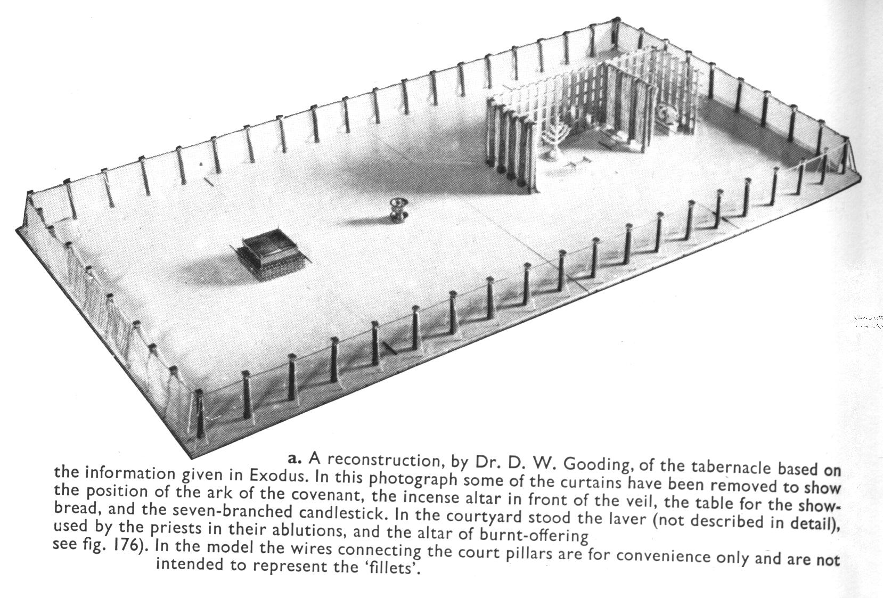
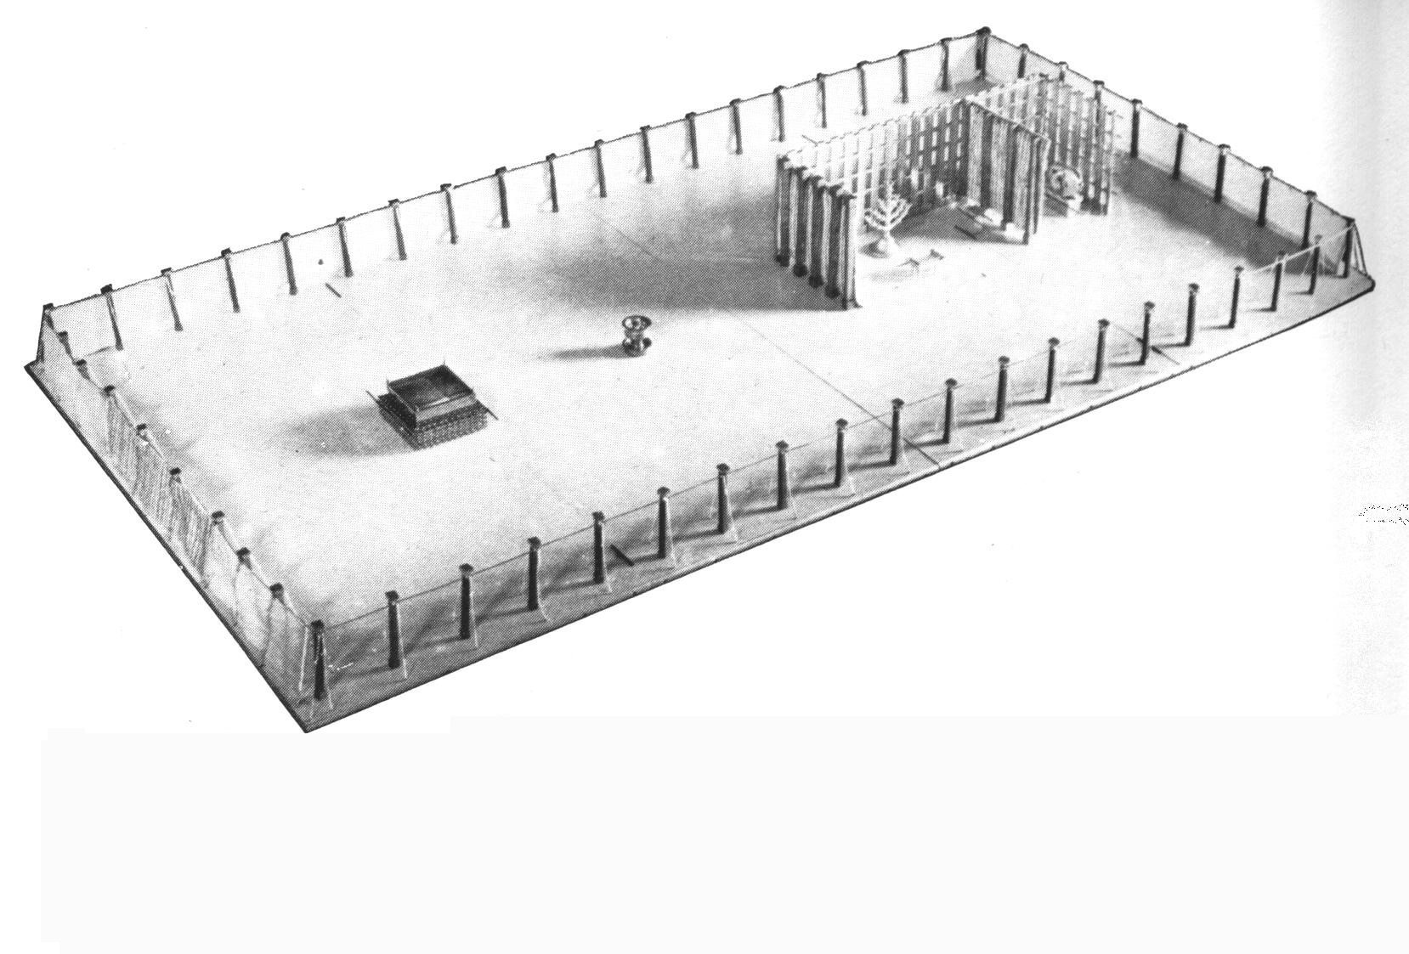

Slide 9
THE TABERNACLE Typifies man’s approach to God
The Outer Court – Brass - symbol of judgement
The Brazen Alter – Sin must first be dealt with
The Laver – The process of sanctification - Eph 5:26 That he might sanctify and cleanse it with the washing of water by the word,

Slide 10
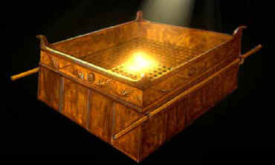
THE BRAZEN ALTAR

Slide 11
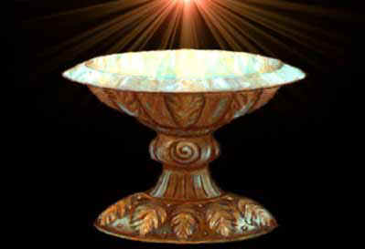
THE LAVER

Slide 12
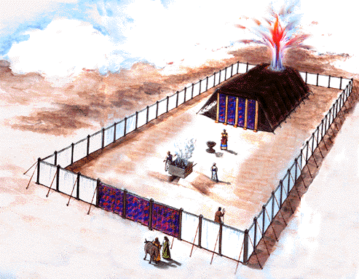

Slide 13
The Holy Place
Gold – symbol of Divinity
Candlestick – Oil needed for the light – symbol of Holy Spirit
Table of Shewbread – Symbol of Jesus of the beard of life
Alter of incense – Symbol of prayer

Slide 14
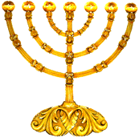
THE GOLDEN CANDLESTICK

Slide 15
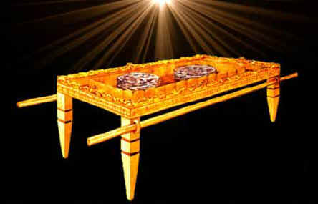
TABLE OF SHEWBREAD

Slide 16
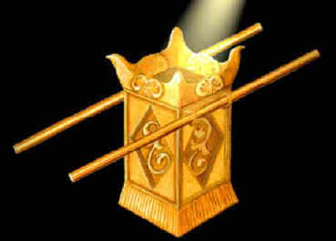
ALSO CALLED THE GOLDEN ALTAR

Slide 17
THE VEIL
Symbol of the nature of Christ
Embroidered with the cherubim
Face of the lion – Royal nature
Face of the ox – Servant
Face of the eagle – Over comer
Face of the man – Humanity of Christ

Slide 18
Matthew 27:51
And, behold, the veil of the temple was rent in twain from the top to the bottom; and the earth did quake, and the rocks rent;

Slide 19
Heb 10:19 Having therefore, brethren, boldness to enter into the holiest by the blood of Jesus,
Heb 10:20 By a new and living way, which he hath consecrated for us, through the veil, that is to say, his flesh;
Heb 10:21 And having an high priest over the house of God;

Slide 20
Hebrews 6:19
Which hope we have as an anchor of the soul, both sure and stedfast, and which entereth into that within the veil;

Slide 21
The Holy of Holies
The Ark of the Covenant – Symbol of the presence of God
The Mercy Seat – Place of atonement – symbol of the Throne of God

Slide 22
ACCESS TO THE LORD
THE VEIL WAS RENT AT CHRIST’S DEATH
JESUS HAS PROVIDED US ACCESS TO THE THRONE
JEUSUS IS OUR HIGH PRIEST
WE CAN ENTER HIS PRECENSE FREELY

Slide 23
THE ARK OF THE COVENANT
A POT OF MANNA
THE TABLES OF THE TEN COMMANDMENTS
AARON’S ROD THE BUDDED
Three objects in one ark – symbol of the Trinity

